Slide 1
Operating Systems CSE-204
Dr. Durr-e-Nayab
nayab.khan@uetpeshawar.edu.pk

Slide 2
Course Learning Outcomes
CLO-1: Understand the basic concepts behind implementation of Operating Systems, their types, structures, features and services
CLO-2: Demonstrate the concepts of processes, multiprocessing and multithreading in solving different problems
CLO-3: Understand and analyze CPU/Process scheduling and synchronization algorithms.

Slide 3
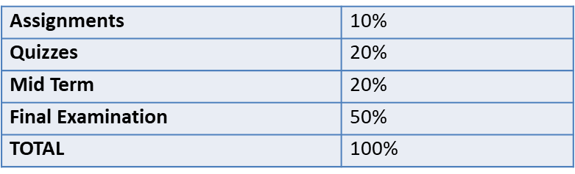
Grading Criteria
In an ideal scenario:
6 Assignments: 3 assignments before midterm and 3 before finalterm exam
6 Quizzes: 3 quizzes before midterm and 3 before finalterm exam, based on assignments
RESOURCES
BOOKs RECOMMENDED
Abraham Silberschatz, Peter Baer Galvin, and Greg Gagne: Operating System Concepts, 9th or later Edition (Uploaded in google classroom)
REFERENCE BOOKS
UNIX Systems Programming: Communication, Concurrency, and Threads by K. A. Robbins and S. Robbins. Prentice Hall, 2003. ISBN: 0-13-042411-0.

Slide 4
About Lectures
In an effort to make this course enjoyable for everybody:
Be on time! This will only benefit YOU!
If you have any queries, Just ask me or write it down!
Class participation is mandatory. Do not just sit to receive.
Please turn off your pagers and cell-phones or on silent! If you have any important or expected one, attend it outside the class
Bring your own book, table, notebook and calculator
In your written works it is unacceptable to use someone else's work without reference. Copied assignments, quizzes or other tasks will be tantamount to cheating and no grading will be done.
Your work will never be re-evaluated for rejected/missed assignment.
Class representatives should collect and submit the assignments, quizzes and requests on behalf of their section in my office once and for all.

Slide 5
Operating Systems CSE-204
Overview What are operating systems. What operating systems do. How the operating systems are designed and constructed.
Process management and Process coordination Process concepts and concurrency Inter-Process communication, scheduling, process synchronization, and deadlock handling, and priorities
Memory management and Storage management Main memory during the execution of a process Utilization of the CPU and the speed of its response File system, mass storage, and I/0 handling in a modern computer system
Protection and security Processes in an OS must be protected from one another's activities Controlling the access of programs, processes, or users to the resources
Distributed systems and special purpose systems Processors that do not share memory or a clock Mechanisms for process synchronization and communication

Slide 6
Chapter 1: Introduction
Notes:
‹#›

Slide 7
Chapter 1: Introduction
What is Operating Systems
Computer-System Organization
Computer-System Architecture
Operating-System Structure
Operating-System Operations
Process Management
Memory Management
Storage Management

Slide 8
Agenda for Today
Describe Operating Systems in the context of Computer Systems
Operating Systems from User and System perspective
What does Operating Systems do?
To explore several open-source operating systems
Some core concepts
OS kernel, OS modes
Processes, Types, Attributes
Threads, Types, Attributes
Interrupts, Interrupt Vector, Interrupt Handling/ Service
System/ I/O Calls
Polling/ Signals
Trap/ Exception, Trap handling / Service
Program Counter

Slide 9
What is an Operating System?
A program that acts as an intermediary between a user of a computer and the computer hardware
Operating system goals:
Execute user programs and make solving user problems easier
Make the computer system convenient to use
Use the computer hardware in an efficient manner

Slide 10
Computer System Structure
Computer system can be divided into four components:
Hardware – provides basic computing resources
CPU, memory, I/O devices
Operating system
Controls and coordinates use of hardware among various applications and users
Application programs – define the ways in which the system resources are used to solve the computing problems of the users
Word processors, compilers, web browsers, database systems, video games
Users
People, machines, other computers

Slide 11
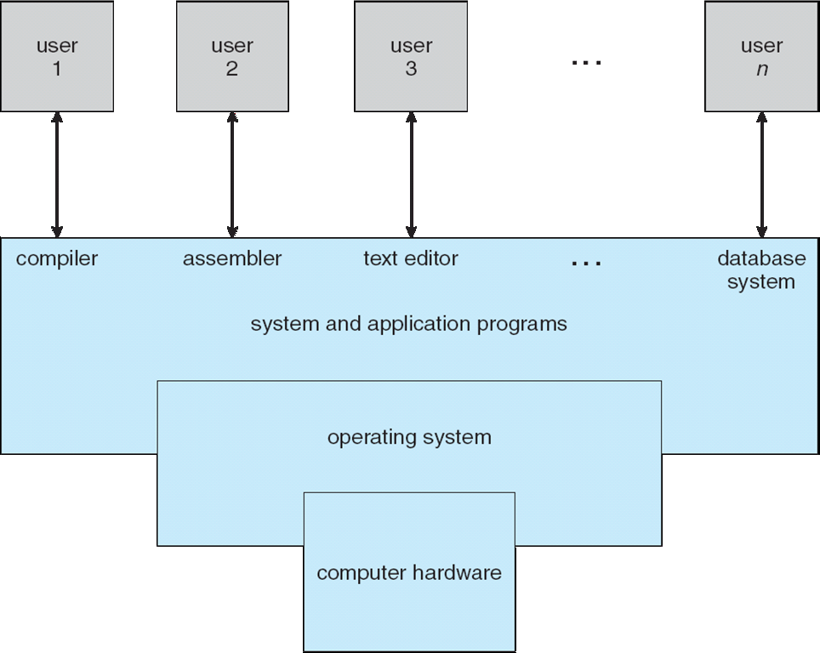
Four Components of a Computer System

Slide 12
What Operating Systems Do
Depends on the point of view
Users want convenience, ease of use and good performance
Don’t care about resource utilization
But shared computer such as mainframe or minicomputer must keep all users happy
Users of dedicated systems such as workstations have dedicated resources but frequently use shared resources from servers
Handheld computers are resource poor, optimized for usability and battery life
Some computers have little or no user interface, such as embedded computers in devices and automobiles

Slide 13
Operating System Definition
OS is a resource allocator
Manages all resources
Decides between conflicting requests for efficient and fair resource use
OS is a control program
Controls execution of programs to prevent errors and improper use of the computer

Slide 14
Operating System Definition (Cont.)
No universally accepted definition
“Everything a vendor ships when you order an operating system” is a good approximation
But varies wildly
“The one program running at all times on the computer” is the kernel.
Everything else is either
a system program (ships with the operating system) , or
an application program.

Slide 15
Computer Startup
Bootstrap program is loaded at power-up or reboot
Typically stored in ROM or EPROM, generally known as firmware
Initializes all aspects of system
Loads operating system kernel and starts execution

Slide 16
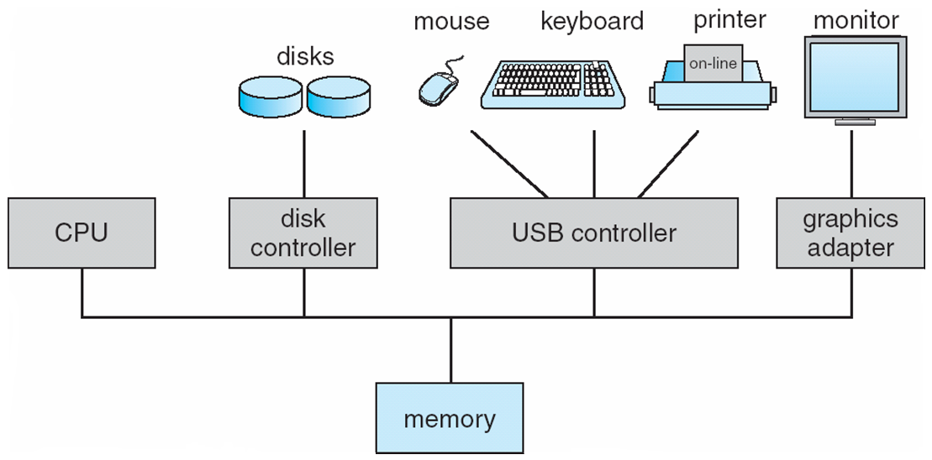
Computer System Organization
Computer-system operation
One or more CPUs, device controllers connect through common bus providing access to shared memory
Concurrent execution of CPUs and devices competing for memory cycles

Slide 17
Computer-System Operation
I/O devices and the CPU can execute concurrently
Each device controller is in charge of a particular device type
Each device controller has a local buffer
CPU moves data from/to main memory to/from local buffers
I/O is from the device to local buffer of controller
Device controller informs CPU that it has finished its operation by causing an interrupt

Slide 18
Common Functions of Interrupts
Interrupt transfers control to the interrupt service routine generally, through the interrupt vector, which contains the addresses of all the service routines
Interrupt architecture must save the address of the interrupted instruction
A trap or exception is a software-generated interrupt caused either by an error or a user request, conditions like invalid memory access, division by zero, or a breakpoint can trigger a trap in an OS. Invokes Kernel Routine.
An operating system is interrupt driven

Slide 19
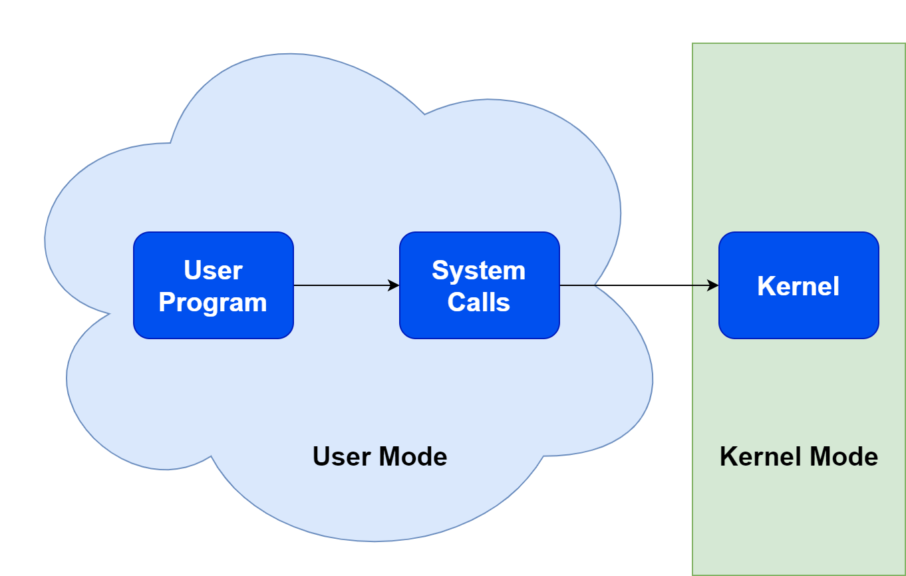
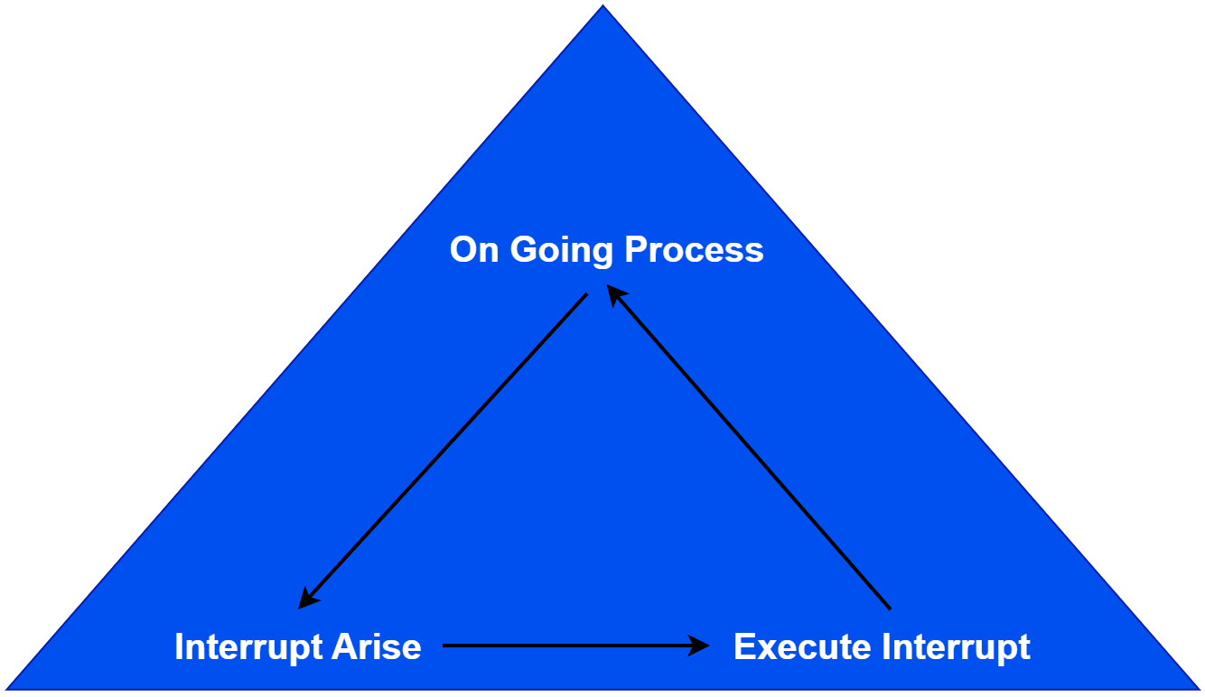
Interrupt Handling
The operating system preserves the state of the CPU by storing registers and the program counter
Determines which type of interrupt has occurred:
polling
vectored interrupt system
Separate segments of code determine what action should be taken for each type of interrupt
System call/ user process versus Interrupts

Slide 20
Operating-System Operations
Interrupt driven (hardware and software)
Hardware interrupt by one of the devices
Software interrupt (exception or trap):
Software error (e.g., division by zero)
Request for operating system service
Other process problems include infinite loop, processes modifying each other or the operating system

Slide 21
I/O Structure
After I/O starts, control returns to user program only upon I/O completion
Wait instruction idles the CPU until the next interrupt
Wait loop (contention for memory access)
At most one I/O request is outstanding at a time, no simultaneous I/O processing
After I/O starts, control returns to user program without waiting for I/O completion
System call – request to the OS to allow user to wait for I/O completion
Device-status table contains entry for each I/O device indicating its type, address, and state
OS indexes into I/O device table to determine device status and to modify table entry to include interrupt

Slide 22
Operating-System Operations (cont.)
Dual-mode operation allows OS to protect itself and other system components
User mode and kernel mode
Mode bit provided by hardware
Provides ability to distinguish when system is running user code or kernel code
Some instructions designated as privileged, only executable in kernel mode
System call changes mode to kernel, return from call resets it to user
Increasingly CPUs support multi-mode operations
i.e. virtual machine manager (VMM) mode for guest VMs

Slide 23
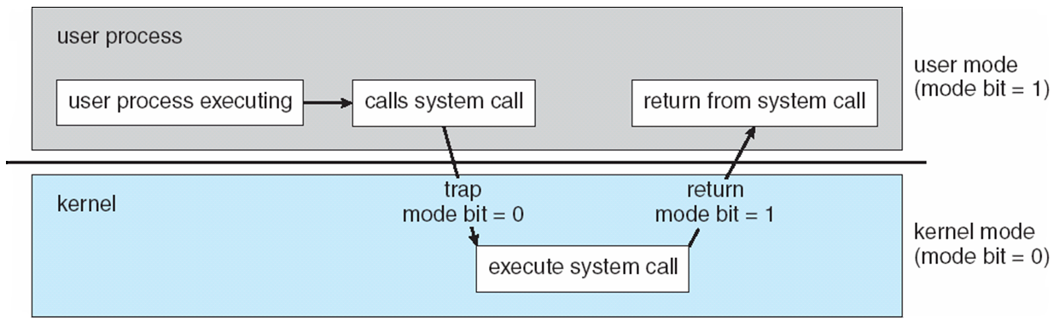
Transition from User to Kernel Mode
Timer to prevent infinite loop / process hogging resources
Timer is set to interrupt the computer after some time period
Keep a counter that is decremented by the physical clock.
Operating system set the counter (privileged instruction)
When counter zero generate an interrupt
Set up before scheduling process to regain control or terminate program that exceeds allotted time

Slide 24
Entry Points to Kernel Mode
Interrupts
Signals
Kernel
System Call
Traps
Notes:
‹#›

Slide 25
I/O Structure
After I/O starts, control returns to user program only upon I/O completion
Wait instruction idles the CPU until the next interrupt
Wait loop (contention for memory access)
At most one I/O request is outstanding at a time, no simultaneous I/O processing
After I/O starts, control returns to user program without waiting for I/O completion
System call – request to the OS to allow user to wait for I/O completion
Device-status table contains entry for each I/O device indicating its type, address, and state
OS indexes into I/O device table to determine device status and to modify table entry to include interrupt

Slide 26
Process Management
A process is a program in execution. It is a unit of work within the system. Program is a passive entity, process is an active entity.
Process needs resources to accomplish its task
CPU, memory, I/O, files
Initialization data
Process termination requires reclaim of any reusable resources
Single-threaded process has one program counter specifying location of next instruction to execute
Process executes instructions sequentially, one at a time, until completion
Multi-threaded process has one program counter per thread
Typically system has many processes, some user, some operating system running concurrently on one or more CPUs
Concurrency by multiplexing the CPUs among the processes / threads

Slide 27
Process Management Activities
The operating system is responsible for the following activities in connection with process management:
Creating and deleting both user and system processes
Suspending and resuming processes
Providing mechanisms for process synchronization
Providing mechanisms for process communication
Providing mechanisms for deadlock handling

Slide 28
Memory Management
To execute a program all (or part) of the instructions must be in memory
All (or part) of the data that is needed by the program must be in memory.
Memory management determines what is in memory and when
Optimizing CPU utilization and computer response to users
Memory management activities
Keeping track of which parts of memory are currently being used and by whom
Deciding which processes (or parts thereof) and data to move into and out of memory
Allocating and deallocating memory space as needed

Slide 29
Storage Management
OS provides uniform, logical view of information storage
Abstracts physical properties to logical storage unit - file
Each medium is controlled by device (i.e., disk drive, tape drive)
Varying properties include access speed, capacity, data-transfer rate, access method (sequential or random)
File-System management
Files usually organized into directories
Access control on most systems to determine who can access what
OS activities include
Creating and deleting files and directories
Primitives to manipulate files and directories
Mapping files onto secondary storage
Backup files onto stable (non-volatile) storage media

Slide 30
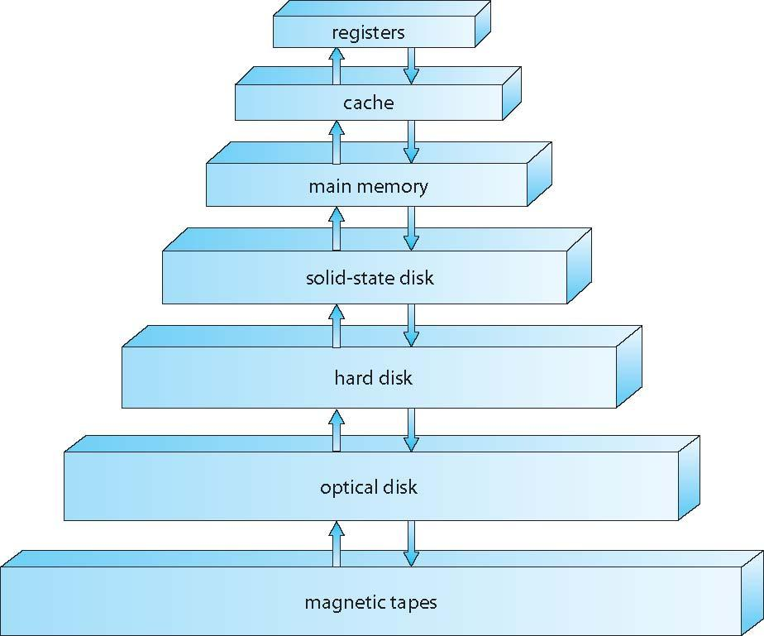
Storage-Device Hierarchy

Slide 31
Mass-Storage Management
Usually disks used to store data that does not fit in main memory or data that must be kept for a “long” period of time
Proper management is of central importance
Entire speed of computer operation hinges on disk subsystem and its algorithms
OS activities
Free-space management
Storage allocation
Disk scheduling
Some storage need not be fast
Tertiary storage includes optical storage, magnetic tape
Still must be managed – by OS or applications
Varies between WORM (write-once, read-many-times) and RW (read-write)

Slide 32
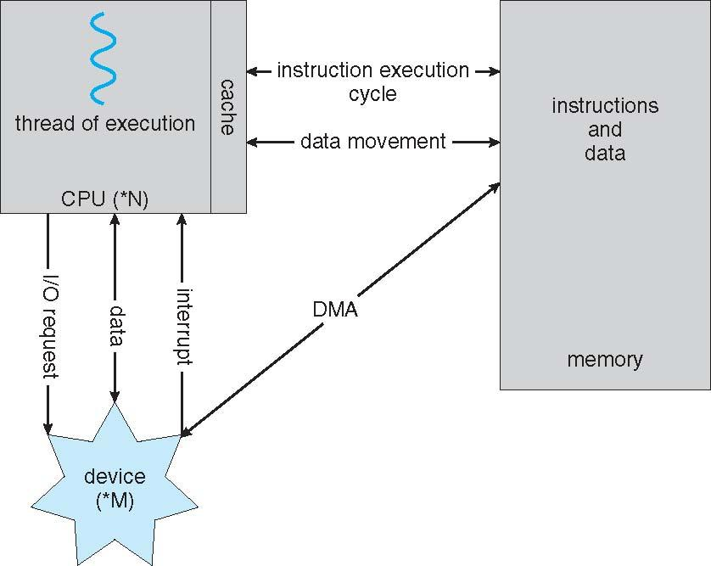
How a Modern Computer Works
A von Neumann architecture

Slide 33
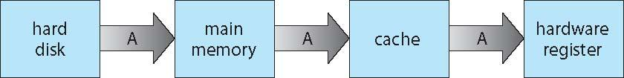
Migration of data “A” from Disk to Register
Multitasking environments must be careful to use most recent value, no matter where it is stored in the storage hierarchy
Multiprocessor environment must provide cache coherency in hardware such that all CPUs have the most recent value in their cache
Distributed environment situation even more complex
Several copies of a datum can exist
Various solutions covered in Chapter 17

Slide 34
Protection and Security
Protection – any mechanism for controlling access of processes or users to resources defined by the OS
Security – defense of the system against internal and external attacks
Huge range, including denial-of-service, worms, viruses, identity theft, theft of service
Systems generally first distinguish among users, to determine who can do what
User identities (user IDs, security IDs) include name and associated number, one per user
User ID then associated with all files, processes of that user to determine access control
Group identifier (group ID) allows set of users to be defined and controls managed, then also associated with each process, file
Privilege escalation allows user to change to effective ID with more rights

Slide 35
Computing Environments - Virtualization
Use cases involve laptops and desktops running multiple OSes for exploration or compatibility
Apple laptop running Mac OS X host, Windows as a guest
Developing apps for multiple OSes without having multiple systems
QA testing applications without having multiple systems
Executing and managing compute environments within data centers
VMM can run natively, in which case they are also the host
There is no general purpose host then (VMware ESX and Citrix XenServer)

Slide 36
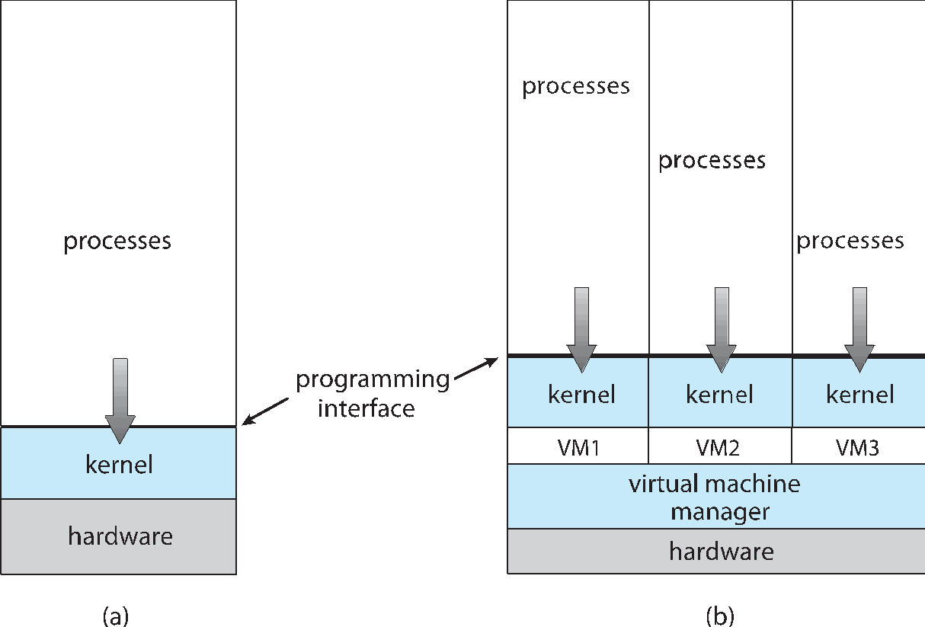
Computing Environments - Virtualization

Slide 37
Operating System Concepts
Types of Operating Systems
Single User Systems (Personal Computer systems)
Only one user at a time 🢡 Single Tasking Systems
Interactive and executes codes for single user only
Processes of one user only (Process / CPU scheduling)
Single-Tasking (MS DOS/ Palm OS)
Multi-Tasking (Windows, UNIX, LINUX, MAC OS)
Pre-Emptive Mode (Predefined slots for each process)
Co-operative Mode (Inter process communication)
Multiprogramming (Batch system) needed for efficiency
Single user cannot keep CPU and I/O devices busy at all times
Multiprogramming organizes jobs (code and data) so CPU always has one to execute
A subset of total jobs in system is kept in memory
One job selected and run via Job scheduling
When it has to wait (for I/O for example), OS switches to another job
Example: payroll system, Bills, reports printing systems, Network simulators

Slide 38
Operating System Concepts
Types of Operating Systems
Multi Processing (multitasking) is logical extension in which CPU switches processes of similar kind frequently to give impression of parallelism
Similar Processes
Switching between CPU Burst and I/O burst 🢡 Concurrent Process Management
If several jobs ready to run at the same time 🢡 Inter Process Communication
If processes don’t fit in memory, swapping moves them in and out to run
Example: Single User Systems, Windows, MAC OS

Slide 39
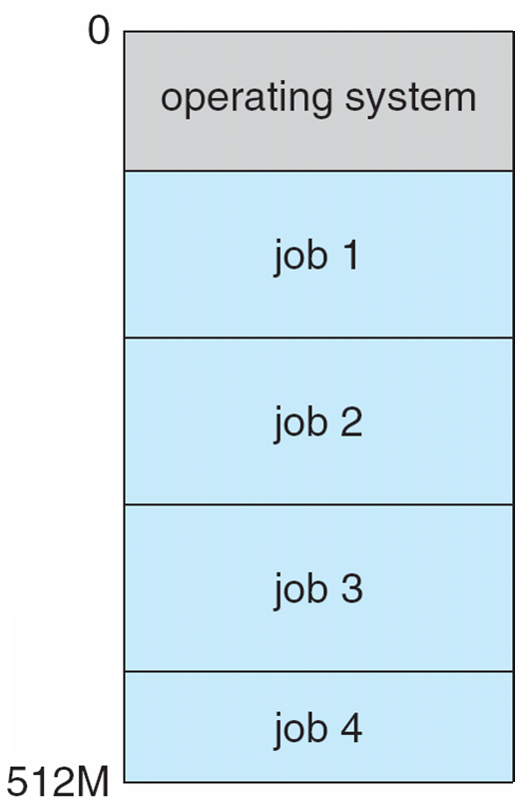
Memory Layout for OS System
process 1
process 2
process 3
process 4
Multi Program (Batch System)
Each similar job has its own CPU and I/O bursts
Multi Process (Multi Tasking System)
Each similar process has its own CPU and I/O bursts

Slide 40
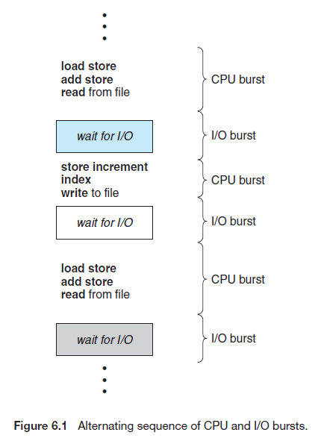
Process Life Cycle

Slide 41
Process Life Cycle
Example: Two Processes P1 and P2.
Process 1
(5 CPU time units and 5 I/O time units)
Process 2
(5 CPU time units and 5 I/O time units)
Dots: I/O Burst
Dash: CPU Burst

Slide 42
Operating System Concepts
Timesharing (Multitasking and Multi users) is logical extension in which CPU switches jobs so frequently that users can interact with each job while it is running, creating interactive computing
Response time should be < 1 second
Each user has at least one program executing in memory 🢡process
If several jobs ready to run at the same time 🢡 CPU scheduling
If processes don’t fit in memory, swapping moves them in and out to run
A single CPU is shared among multiple users
A short time is assigned to each users process 🢡 Quantum, Slice, Slot
Virtual memory allows execution of processes not completely in memory
Example: LINUX OS, UNIX OS

Slide 43
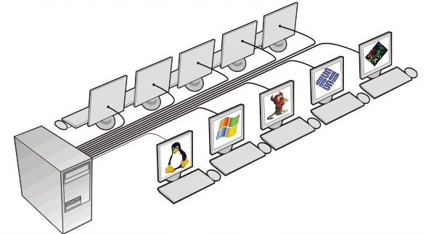
Operating System Concepts
Process U1
Process U2
Process U3
Process U4
Multi User (Time sharing System)
Each users similar process has its own CPU and I/O bursts

Slide 44
Operating System Concepts
Real Time OS (Time Critical) gives response in real time, critical time constraints
Response time should be very fast
Once interrupt is given, responds abruptly
Real-time operating systems are Event-driven and Pre-Emptive, meaning the OS can monitor the relevant priority of competing tasks, and make changes to the task priority. Event-driven systems switch between tasks based on their priorities
Hard RTOS: Crucial applications e.g. medical applications, ventilator systems, medical imaging systems, rockets and robotics
Soft RTOS: Not crucial but real time response required e.g. Networking, sign boards

Slide 45
Open-Source Operating Systems
Operating systems made available in source-code format rather than just binary closed-source
Counter to the copy protection and Digital Rights Management (DRM) movement
Started by Free Software Foundation (FSF), which has “copyleft” GNU Public License (GPL)
Examples include GNU/Linux and BSD UNIX (including core of Mac OS X), and many more
Can use VMM like VMware Player (Free on Windows), Virtualbox (open source and free on many platforms - http://www.virtualbox.com)
Use to run guest operating systems for exploration

Slide 46
End of Chapter 1
Notes:
‹#›

